Slide 1

Real-Time Sign Language Recognition System
Khulna University of Engineering & Technology
Department of Computer Science and Engineering
Presented By:
Name: Shahana Akter
Roll: 1907029
Name: Shrabanti Debnath Urmi
Roll: 1907094
Supervised By:
Md. Repon Islam
Lecturer
Department of CSE,
KUET

Slide 2
Outlines
Introduction
Motivation
Objectives
Contributions
Methodology
User scenario
Limitations
Future Works
Conclusions
References

Slide 3
Introduction
Our project uses MediaPipe and LSTM architecture to develop a Real Time Bengali Sign Language Recognition System.
This closes a significant gap in the field of Bengali sign language recognition technology by providing real-time gesture analysis on an intuitive web interface.
The goal of this project is to reduce the communication gap that often exists between the deaf people who speak Bengali.

Slide 4
Motivation
About 3 million individuals in Bangladesh are deaf or hearing-impaired.
Sign language is a communication technique through which deaf or mute people can communicate with non-disabled people via hand gestures.
The inspiration for the Bengali sign language recognition system comes from a strong desire to support the hearing-impaired Bengali-speaking population.

Slide 5
Objectives
To develop a robust real-time Bengali sign language recognition System with the help of MediaPipe and LSTM architecture.
To embed the system within a user-friendly website, ensuring widespread accessibility.
To provide an effective communication tool for deaf and mute people.
To address the lack of Bengali sign language solutions by offering an innovative system.

Slide 6
Contributions
Our system addresses the lack of Bengali sign language solutions.
Integration into a web interface provides a familiar platform for effective communication in Bengali sign language.
Improved real-time gesture analysis ensures dynamic and responsive communication and contributes to a seamless user experience.
Embedded instructional videos helps users to learn Bengali sign language skills effortlessly.

Slide 7
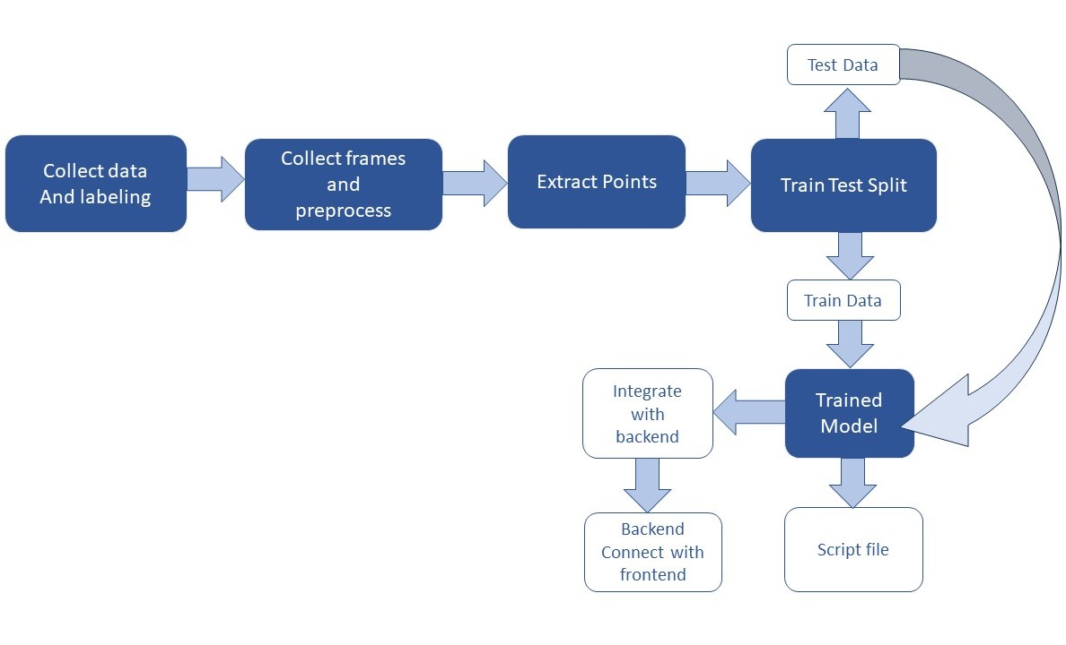
Methodology
Good Morning Everyone Hello
Figure 1: Workflow of Sign Language Recognition System

Slide 8
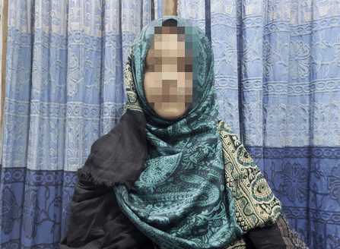
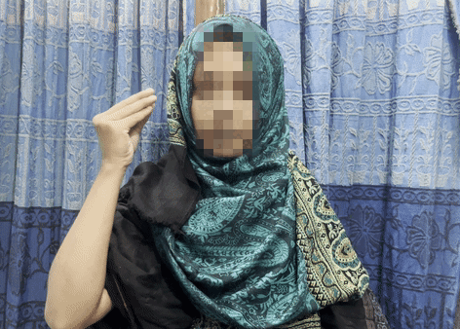
Methodology (Contd.)
Dataset Creation
We developed a custom Bengali Sign Language video dataset for authenticity.
Figure 2: Sign Language dataset for the word “শুভ”
Figure 3: Sign Language dataset for the word “সকাল”

Slide 9
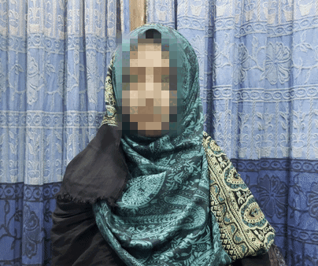
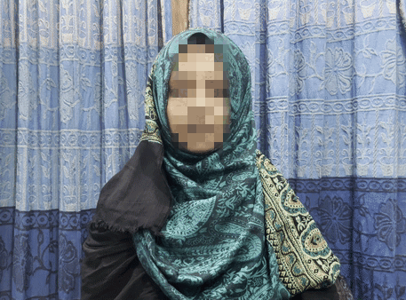
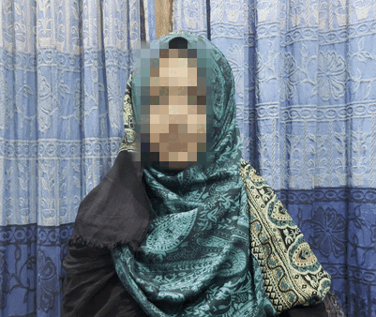
Methodology (Contd.)
Figure 4: Sign Language dataset for the word “আপনি”
Figure 5: Sign Language dataset for the word “কেমন”
Figure 6: Sign Language dataset for the word “আছেন”

Slide 10
Methodology (Contd.)
System Architecture
We utilized MediaPipe for gesture detection.
Employed LSTM architecture for sequence learning.

Slide 11
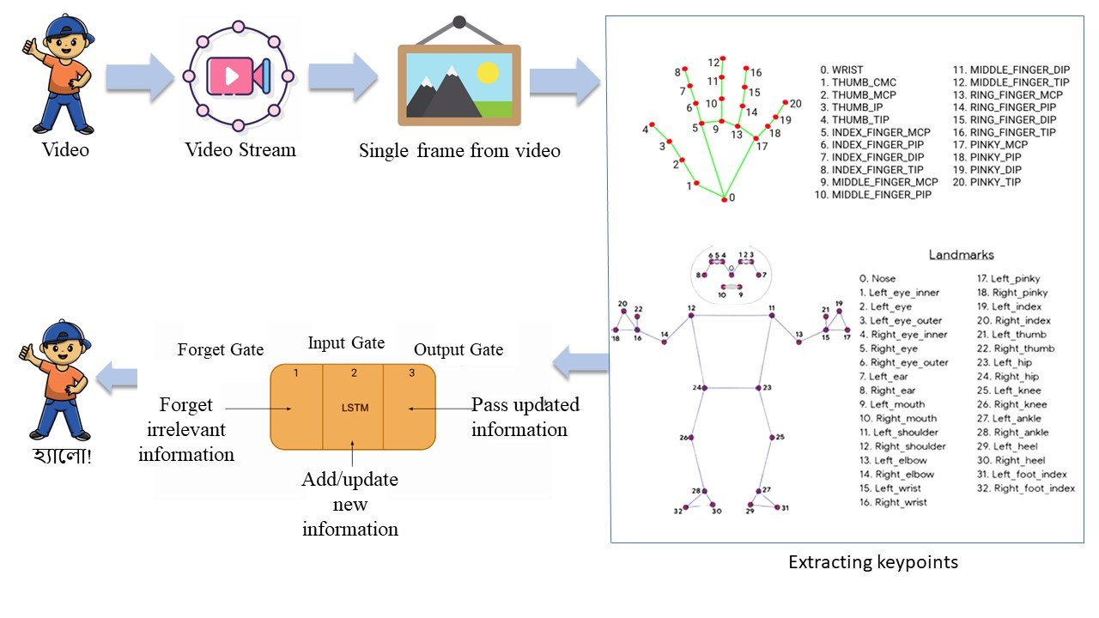
Methodology (Contd.)
Figure 7: System Architecture of Sign Language Recognition System

Slide 12
Methodology (Contd.)
Model Training
We implemented deep learning models for real-time analysis.
Trained the model using custom dataset to recognize Bengali sign language.

Slide 13
Methodology (Contd.)
LSTM in Sign Language Recognition System
LSTM can capture long-term dependencies in the sequential data.
LSTM has memory cells that can store and retrieve information over long periods.
LSTM can handle input sequences of varying lengths.
LSTM can automatically learn relevant features from the sequential input.

Slide 14
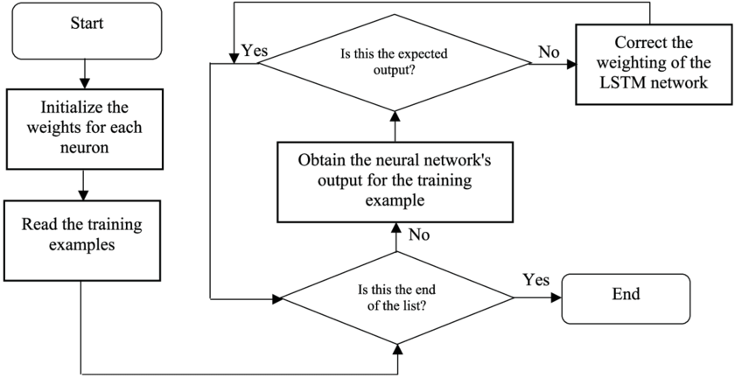
Methodology (Contd.)
LSTM in Sign Language Recognition System
Figure 8: Flowchart for LSTM training

Slide 15
Methodology (Contd.)
Web Integration
Embedded the model into a user-friendly web interface.
Designed intuitive web pages for easy accessibility.
Real-time Translation
Integrated real-time translation of recognized gestures into text.

Slide 16
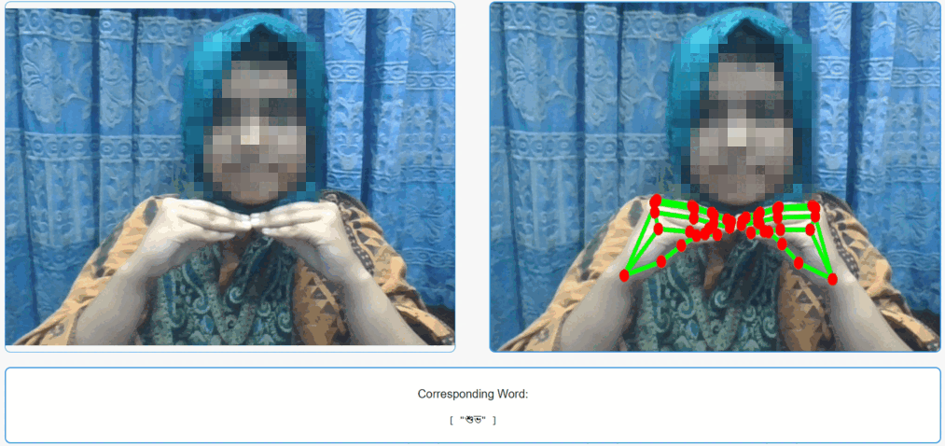
Methodology (Contd.)
Web Integration & Real-time Translation
Figure 9: Web integration and real time translation of the word “শুভ”

Slide 17
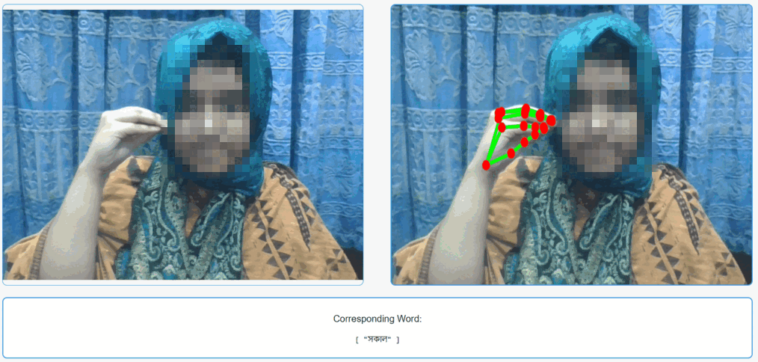
Methodology (Contd.)
Web Integration & Real-time Translation
Figure 10: Web integration and real time translation of the word “সকাল”

Slide 18
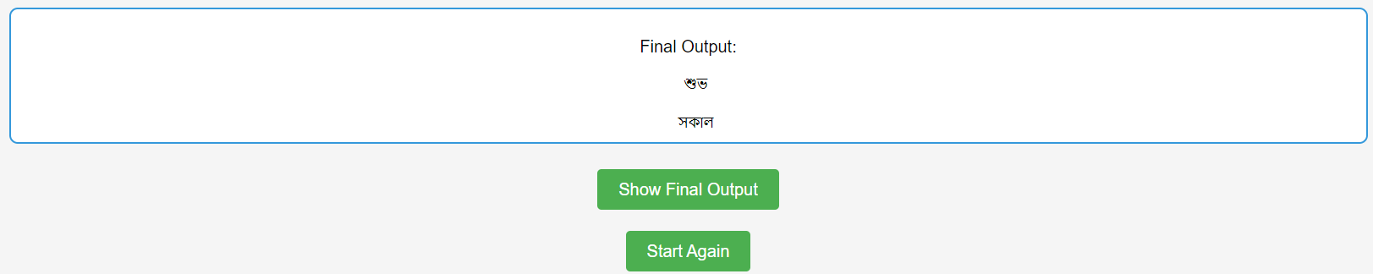
Methodology (Contd.)
Web Integration & Real-time Translation
Figure 11: Final Output of Real-Time Translation

Slide 19
Methodology (Contd.)
Instructional Content
Included instructional videos on the website for user education.
Educated users on making sign language gestures for better interaction.

Slide 20
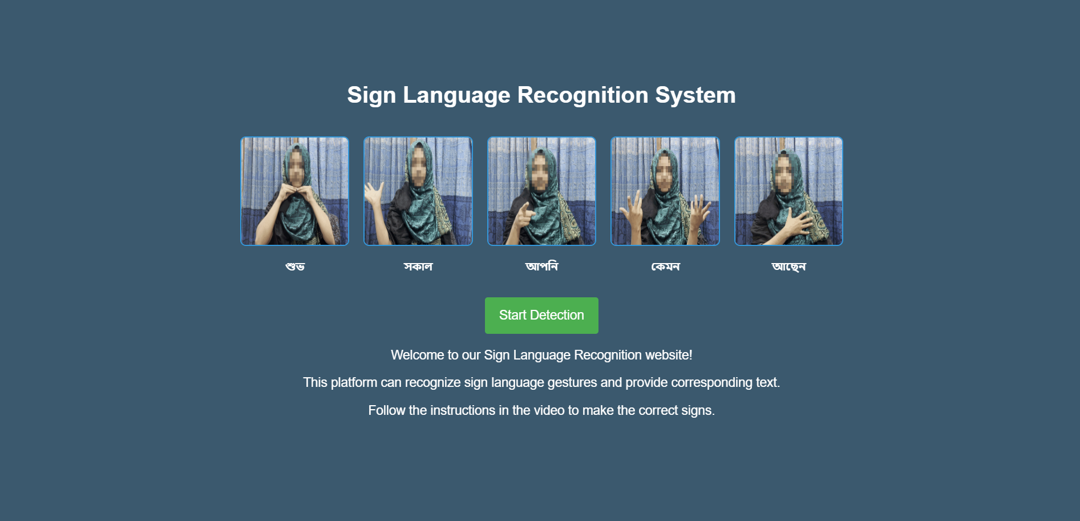
Methodology (Contd.)
Instructional Content
Figure 12: Instructional Contents

Slide 21
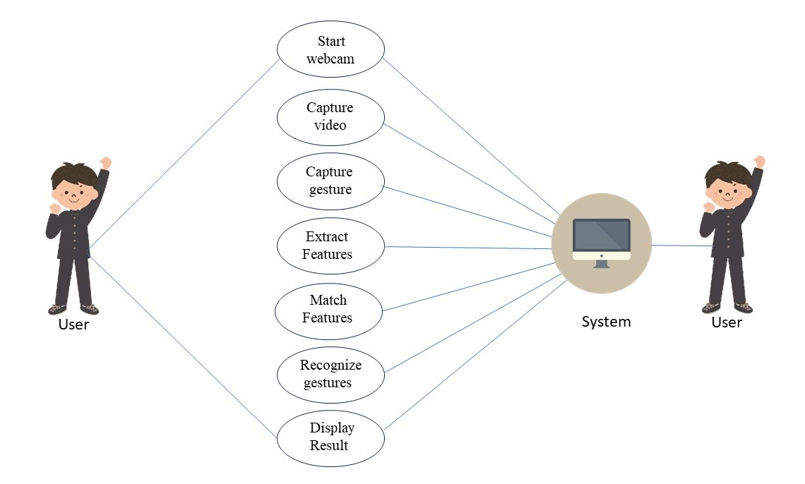
User Scenario
Figure 13: Use Case Diagram of Sign Language Recognition System

Slide 22
Limitations
Our system still have some limitations such as –
Recognizes a specific set of signs, limiting diversity.
Difficulty handling variations in how individuals express signs.
May experience processing delays.
Resource-intensive, challenging on low-powered devices.

Slide 23
Future Works
To add more Bengali sign language gestures for better communication.
To create a mobile application for convenient on-the-go sign language recognition.
To translate recognized sign language gestures into Bengali text and speech in real-time for diverse communication scenarios.

Slide 24
Conclusions
The Bengali Sign Language Recognition System is a big step for closing communication gaps for the Bengali-speaking deaf community.
In addition to recognizing gestures, the system promotes educating through training videos and uses a customized dataset on an easy-to-use website.
For the deaf mute community that speaks Bengali, this system represents a significant advancement in sign language technology.

Slide 25
References
[1] B. Duy Khuat, D. Thai Phung, H. Thi Thu Pham, A. Ngoc Bui, and S. Tung Ngo, “Vietnamese sign language detection using Mediapipe,” 2021 10th International Conference on Software and Computer Applications, Feb. 2021, doi: https://doi.org/10.1145/3457784.3457810.
[2] Md. M. Islam, Md. R. Uddin, M. J. Ferdous, S. Akter, and Md. Nasim Akhtar, “BdSLW-11: Dataset of Bangladeshi sign language words for recognizing 11 daily useful BdSL words,” Data in Brief, vol. 45, p. 108747, Dec. 2022, doi: https://doi.org/10.1016/j.dib.2022.108747.
[3] “Mediapipe Gesture Recognition - Gesture Control in Zoom Call,” learnopencv.com, Jun. 07, 2022. https://learnopencv.com/gesture-control-in-zoom-call-using-mediapipe/ (accessed Nov. 30, 2023).

Slide 26
References
[4] S. saxena, “LSTM | Introduction to LSTM | Long Short Term Memor,” Analytics Vidhya, Mar. 16, 2021. https://www.analyticsvidhya.com/blog/2021/03/introduction-to-long-short-term-memory-lstm/
[5] “The Python Tutorial — Python 3.7.4 documentation,” Python.org, 2019. https://docs.python.org/3/tutorial/index.html
[6] “Welcome to Flask — Flask Documentation (3.0.x),” flask.palletsprojects.com. https://flask.palletsprojects.com/en/3.0.x/
[7] OpenCV, “OpenCV library,” Opencv.org, 2019. https://opencv.org/

Slide 27
Thank You

